Slide 1
SIT PROJECT Speech Recognition in MATLAB using FFT
MEMBERS:
ANIDHIA SINGH – 16070123123
TANISHKA SHAMBHOJI – 16070123128
SIMRAN SINGH – 16070121056
LIPIKA NAGPAL - 16070123137

Slide 2
ABSTRACT
Speech Recognition is the process of automatically recognizing a certain word spoken by a particular speaker based on individual information included in speech waves. This technique makes it possible to use the speaker’s voice to verify his/her identity and provide controlled access to services like voice based biometrics, database access services, voice based dialing, voice mail and remote access to computers.

Slide 3
Idea of the Project
Biometrics: The term biometrics is presently generally known as "the art of measuring physical qualities, to check a man's character, and have got from the Greek words bio (life) and metric (to quantify) which includes speech recognition, iris and face scans, and fingerprint recognition. Biometric qualities can be further separated in two principle classes:
Physiological: This biometrics is the other sort utilized for distinguishing proof or check purposes. Distinguishing proof alludes to figuring out who a man is. This technique is ordinarily utilized as a part of criminal examinations.
Behavioral: It is utilized for confirmation purposes. Check is deciding whether a man is who they say they are. This strategy takes a Pattern at examples of how certain exercises are performed by a person.

Slide 4
Idea of the project
Speech Recognition: The nature of a speech recognition systems are evaluated by two elements: its accuracy (mistake rate in changing over talked words to advanced information) and speed (how well the product can stay aware of a human speaker).
Speech recognition technology has unlimited applications. Generally, such programming is utilized for programmed interpretations, correspondence, sans hands figuring, restorative translation, mechanical autonomy, mechanized client administration, and a great deal more.
On the off chance that you have ever paid a bill via telephone using an automated system, you have likely profit by speech recognition software.

Slide 5
Types of speech recognition
There are different modes available for Speech Recognition System:
1. Speaker Dependent / Independent System: It must be trained in order to recognize accurately what has been said. To train a system, Speaker is asked to record predefined words or sentences that will be analyzed and that results will be stored.
2. Isolated Word Recognition: It is Simplest mode and less greedy in terms of CPU requirement. Word is surrounded by silence so that boundaries are well known.
3. Continuous Speech Recognition: It assumes that system is able to recognize a sequence of words in a sentence.
4. Keyword Spotting: It is able to identify in a sentence a word corresponding to a particular command. Created to cover the gap between isolated and continuous System.
5. Vocabulary Size: Larger the vocabulary the system can make more errors. So vocabulary size matters.

Slide 6
Simple Voice Biometric[Speaker Recognition] in MATLAB
OBJECTIVES :
The System is extremely simple and based on dominating frequency ( pitch detection).
In this project we have covered:
1) FFT
2) Pitch Detection
3) Using Pitch as Feature
4) Nearest Neighbor Classifier
5) Training And Testing

Slide 7
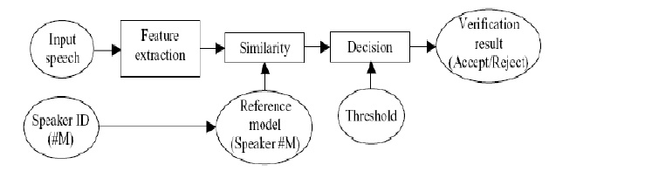
BLOCK DIAGRAM

Slide 8
SPEECH RECOGNITION USING FAST FOURIER TRANSFORM
For speech signals analysis the ordinary transform used called the Fast Fourier transform (FFT). FFT provides the standard representation of a speech signal in the frequency domain. While Short Fourier transform be able to hold time frequency changes. The drawback of FFT that it is not appropriate for the signals whose frequencies are time varying hence in case of FFT is assumes that the signals are stationary in nature .
The FFT allows working in frequency domain and therefore using the frequency spectrum of the speech signal as a substitute of waveform. Frequency domain provides more information about the speech signal and hence can be more efficient to distinguish between speakers. For speaker recognition some techniques use the vice signal acquire directly by the sampling phase and some techniques use transformed form of the speech signal

Slide 9
ALGORITHM
Create an audio object
Recorder = audiorecorder(16000,8,2)
16000khz samples are represented in one sample voice and each sample is represented in 8 bits over 2 channels.
Record the voice for a specific no. of seconds
Recordblocking(record, 5)
Play the recording

Slide 10
Extract the voice data using,
data = getaudiodata(recorder);
Now, FFT is used to change time domain into frequency domain of the audio data.
Syntax, F = fft(data (:,1));
Extracts data from first column and all rows.
Plot
PITCH : voice recognition is based pitch extraction. Every user has a unique pitch, which helps in identifying the user’s voice.
Find out the first instance where maxima is appearing
Extract features
Save the user’s data.
For voice testing, load the database, find out all the distance, and find out the smallest distance.
detect class.

Slide 11
Code for voice training
clear all;
close all;
clc;
%% Creating a recorder object
recorder = audiorecorder(16000, 8, 2); % 16000 Hz, 8 bits, 2 channels
%% Record the user's voice for 5s
disp("Please record your voice:")
drawnow(); % update figures and process callbacks
pause(1)
recordblocking(recorder, 5); % records the audio to recorder object for 5s.
%% Play the user's voice
play(recorder); % plays the audio from the recorder object
data = getaudiodata(recorder); % data is stored in a 80000 x 2 matrix.
plot(data); % plots the data
xlabel("Frequency")
ylabel("Normalized values between -1 to 1")
title("Audio sample")

Slide 12
%% Feature Extraction
f = voiceFeatures(data)
%% Save the user database
user = input("Enter the user number: ");
try
load database
F = [F; f];
C = [C; user];
save database
catch
F = f;
C = user;
save database F C
end
msgbox("Yay! Voice registered!")

Slide 13
Code for extracting features of recorded audio
function [x_Pitch] = voiceFeatures(data)
F = fft(data(:,1)); % converts time domain data to frequency domain of channel 1
plot(real(F)) % plots the real part of the data
m = max(real(F)); % max value of real(F)
x_Pitch = find(real(F) == m, 1); % finds the first indice of max value of real(F)
end

Slide 14
Code for testing of an input audio
clear all;
close all;
clc;
%% Creating a recorder object
recorder = audiorecorder(16000, 8, 2); % 16000 Hz, 8 bits, 2 channels
%% Record the user's voice for 5s
disp("Please record your voice:")
drawnow(); % update figures and process callbacks
pause(1) % pauses for 1s
recordblocking(recorder, 5); % records the audio to recorder object for 5s.
%% Play the user's voice
play(recorder); % plays the audio from the recorder object
data = getaudiodata(recorder); % data is stored in a 8000 x 2 matrix.
plot(data); % plots the data
xlabel("Frequency")
ylabel("Normalized values between -1 to 1")
title("Audio sample")
%% Feature Extraction
f_test = voiceFeatures(data)

Slide 15
%% Find the closest feature from database.
load database
D = [];
for i = 1:size(F, 1)
d = abs(F(i) - f_test);
D = [D d];
end
%% Smallest distance
sm = inf;
ind = -1;
for i = 1:length(D)
if D(i) < sm
sm = D(i);
ind = i;
end
end
detected_class = C(ind);
disp('The detected class is ');
detected_class

Slide 16
Conclusion
We recorded two audios and were able to distinguish between them correctly. We used pitch as the differentiating factor between the audios available for the detection process.
Below are screenshots for both the cases.

Slide 17
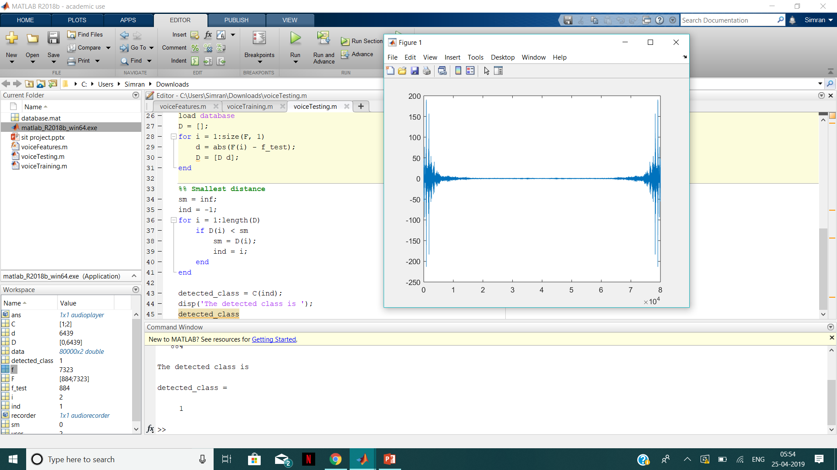
Voice Detection window
Detected class here is 1

Slide 18
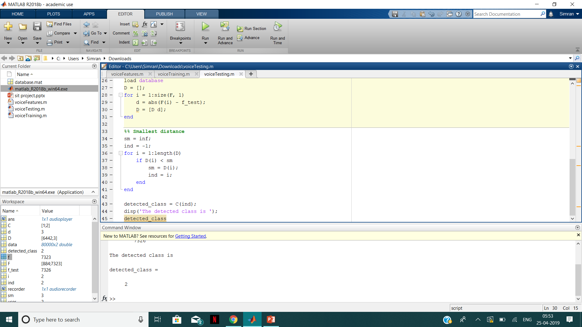
Detected class here is 2.

